Slide 1
NewGen Navigation : Alerting System using Vehicle to Vehicle Communication
Presented by
Manoj Kumar Gopala, Shruti Gopinath, Sramana Dan

Slide 2
Contents
Introduction
System Overview
Number plate detection
Detecting fire due to accidents/forest fire
Detecting signboards
Results
Future Work and conclusion

Slide 3
Introduction
Today’s navigation systems are capable of suggesting routes to optimize time taken, distance covered and traffic conditions.
Our system aims to notify users about hazard signs, hit-and-run accident situations, roadblocks due to natural disasters and ongoing constructions.
We utilize the video stream captured by the cameras placed on the front of the vehicle and process them on MATLAB using the Computer Vision System Toolbox, Image Acquisition Toolbox and Image Processing Toolbox.

Slide 4
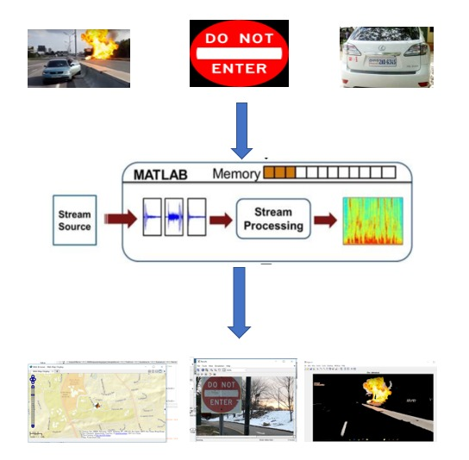
System Overview
Set up database containing images of road signs, hit and run scenario, accident and construction zones.
The stream collected by the camera is processed in MATLAB, frames are extracted from the incoming video and compared with the images in the database
Alert driver with location coordinates recorded when any such situation arises

Slide 5
Number plate detection
The system toolbox provides several algorithms and techniques to detect objects, including pre-trained detection models, as well as functions and an app to train object detectors.
In case of a hit and run situation, the camera records the event and the number plate of the vehicles involved will be extracted and this information can be used for further investigation and assistance.
The algorithm has used horizontal and vertical histogram, which represents the column-wise and row-wise histogram respectively. These histograms represent the sum of differences of gray values between neighbouring pixels of an image, column-wise and row-wise.
We can make use of a feature called Optical Character Recognition (OCR) for extracting number plate from the image and convert it into text format

Slide 6
Detecting fire due to accidents/forest fire
Rule based color model approach has been followed due to its simplicity and effectiveness. RGB and YCbCr color space are chosen as the relation between pixel is more compared to other color models.
For the fire pixel the Cb component is predominantly “black” (lower intensity) while the Cr component, on the other hand, is predominantly “white” (higher intensity).
We can expect that in the fire region of the digital fire image, the value of red channel(R) is greater than the value of green channel (G). Separating the R component, G component and B component in the real fire image, R component can be detected and then the mean values are calculated for the segmented fire region of the original images.
Segmentation is done for the fire flame region and also the fire centre region.

Slide 7
Detecting Sign Boards
We have attempted detection of STOP, YIELD and DO NOT ENTER sign boards.
Each video frame is analyzed in the YCbCr color space. It extracts the portions of the video frame that contain blobs of red pixels by thresholding and performing morphological operations on the Cr channel. The Blob Analysis block finds the pixels and bounding box for each blob.
If a potential sign is detected in 4 contiguous video frames, it compares it to the traffic warning sign recognition templates. When a sign has been recognized, a Insert Text block is used to write the name of the sign on the video stream.

Slide 8
Location Detection
Location detection system is implemented for whenever any of the above mentioned scenarios are encountered.
For this purpose, we make use of MATLAB mobile application. This feature enables us to acquire sensor data from iOS/Android device which includes position information like longitude, latitude, altitude and speed.
This data is sent to MATLAB session and can be used for further analysis and visualization. The data can be combined into a webmap display
The map displaying the location of the event opens in a browser.

Slide 9
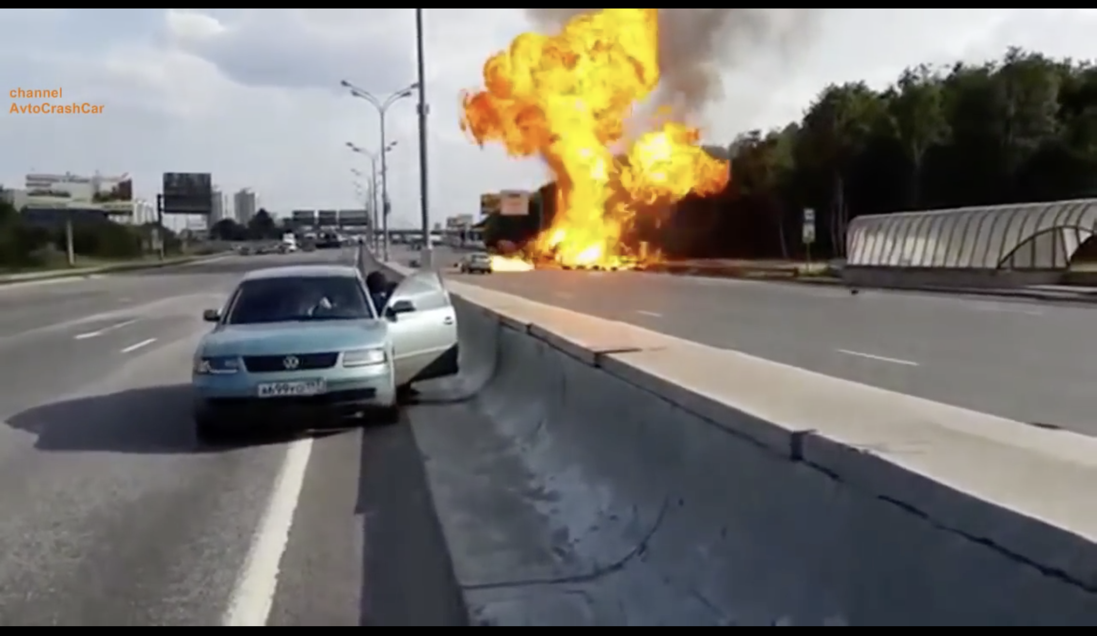
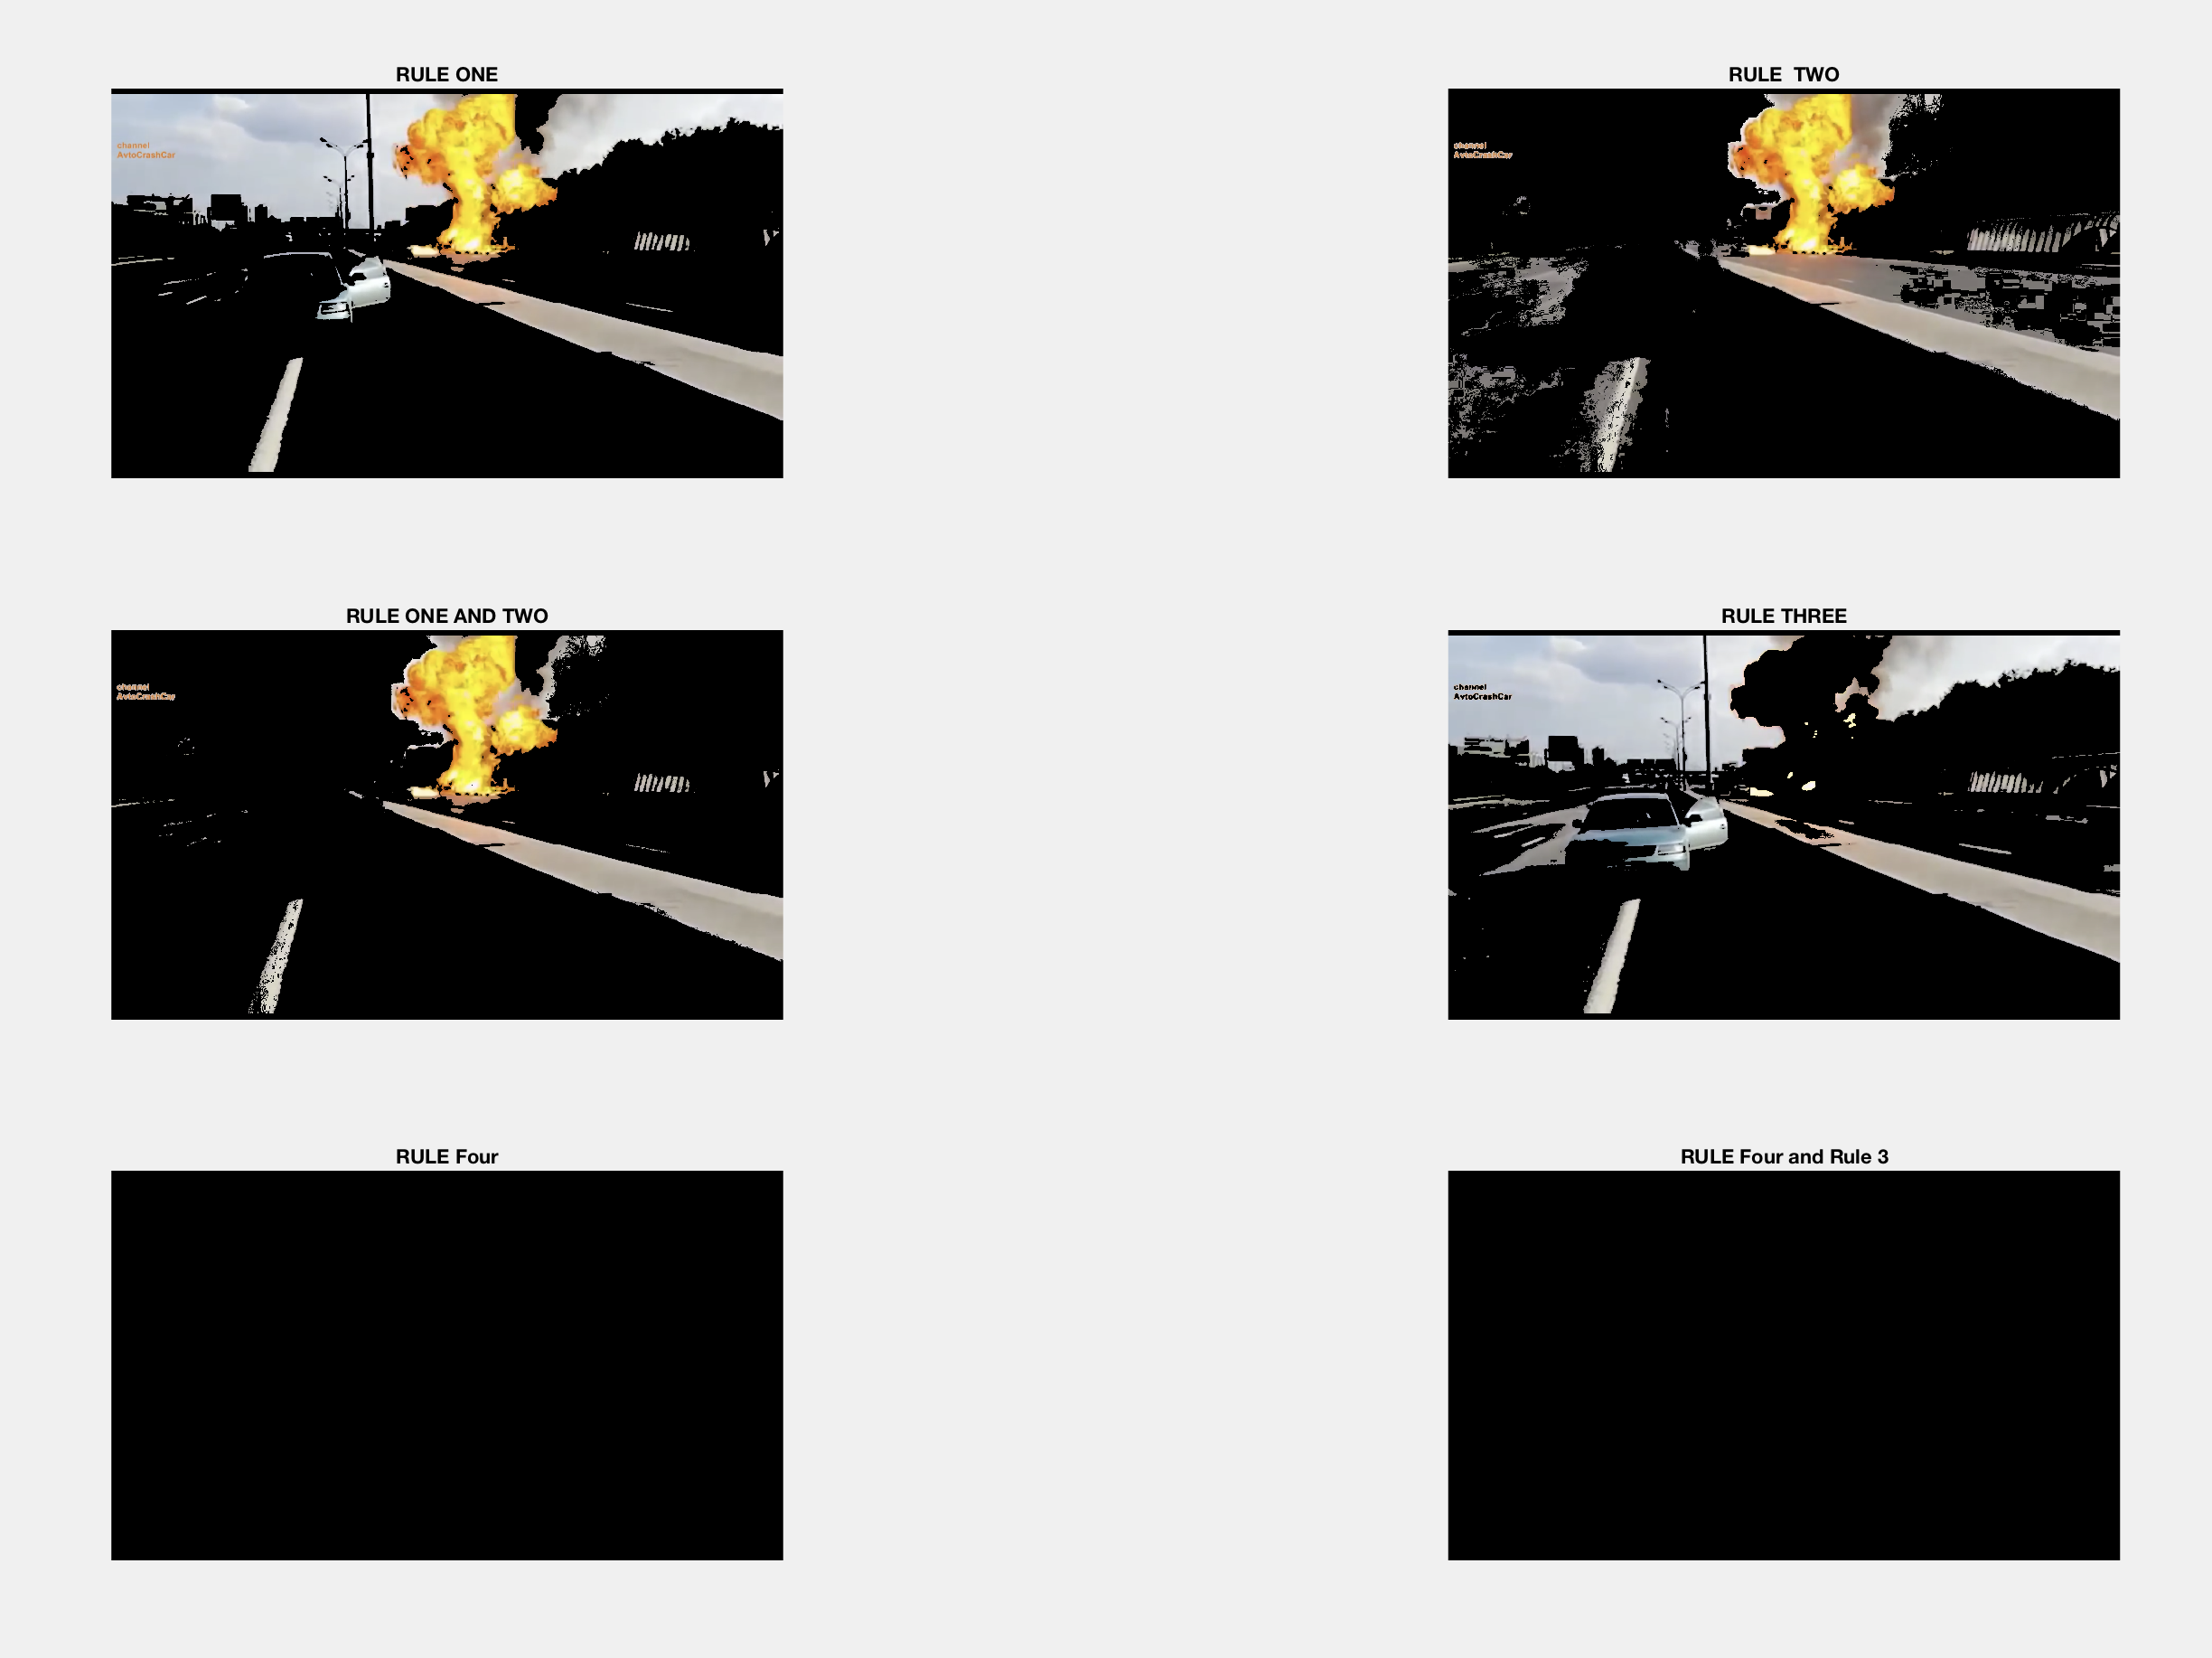
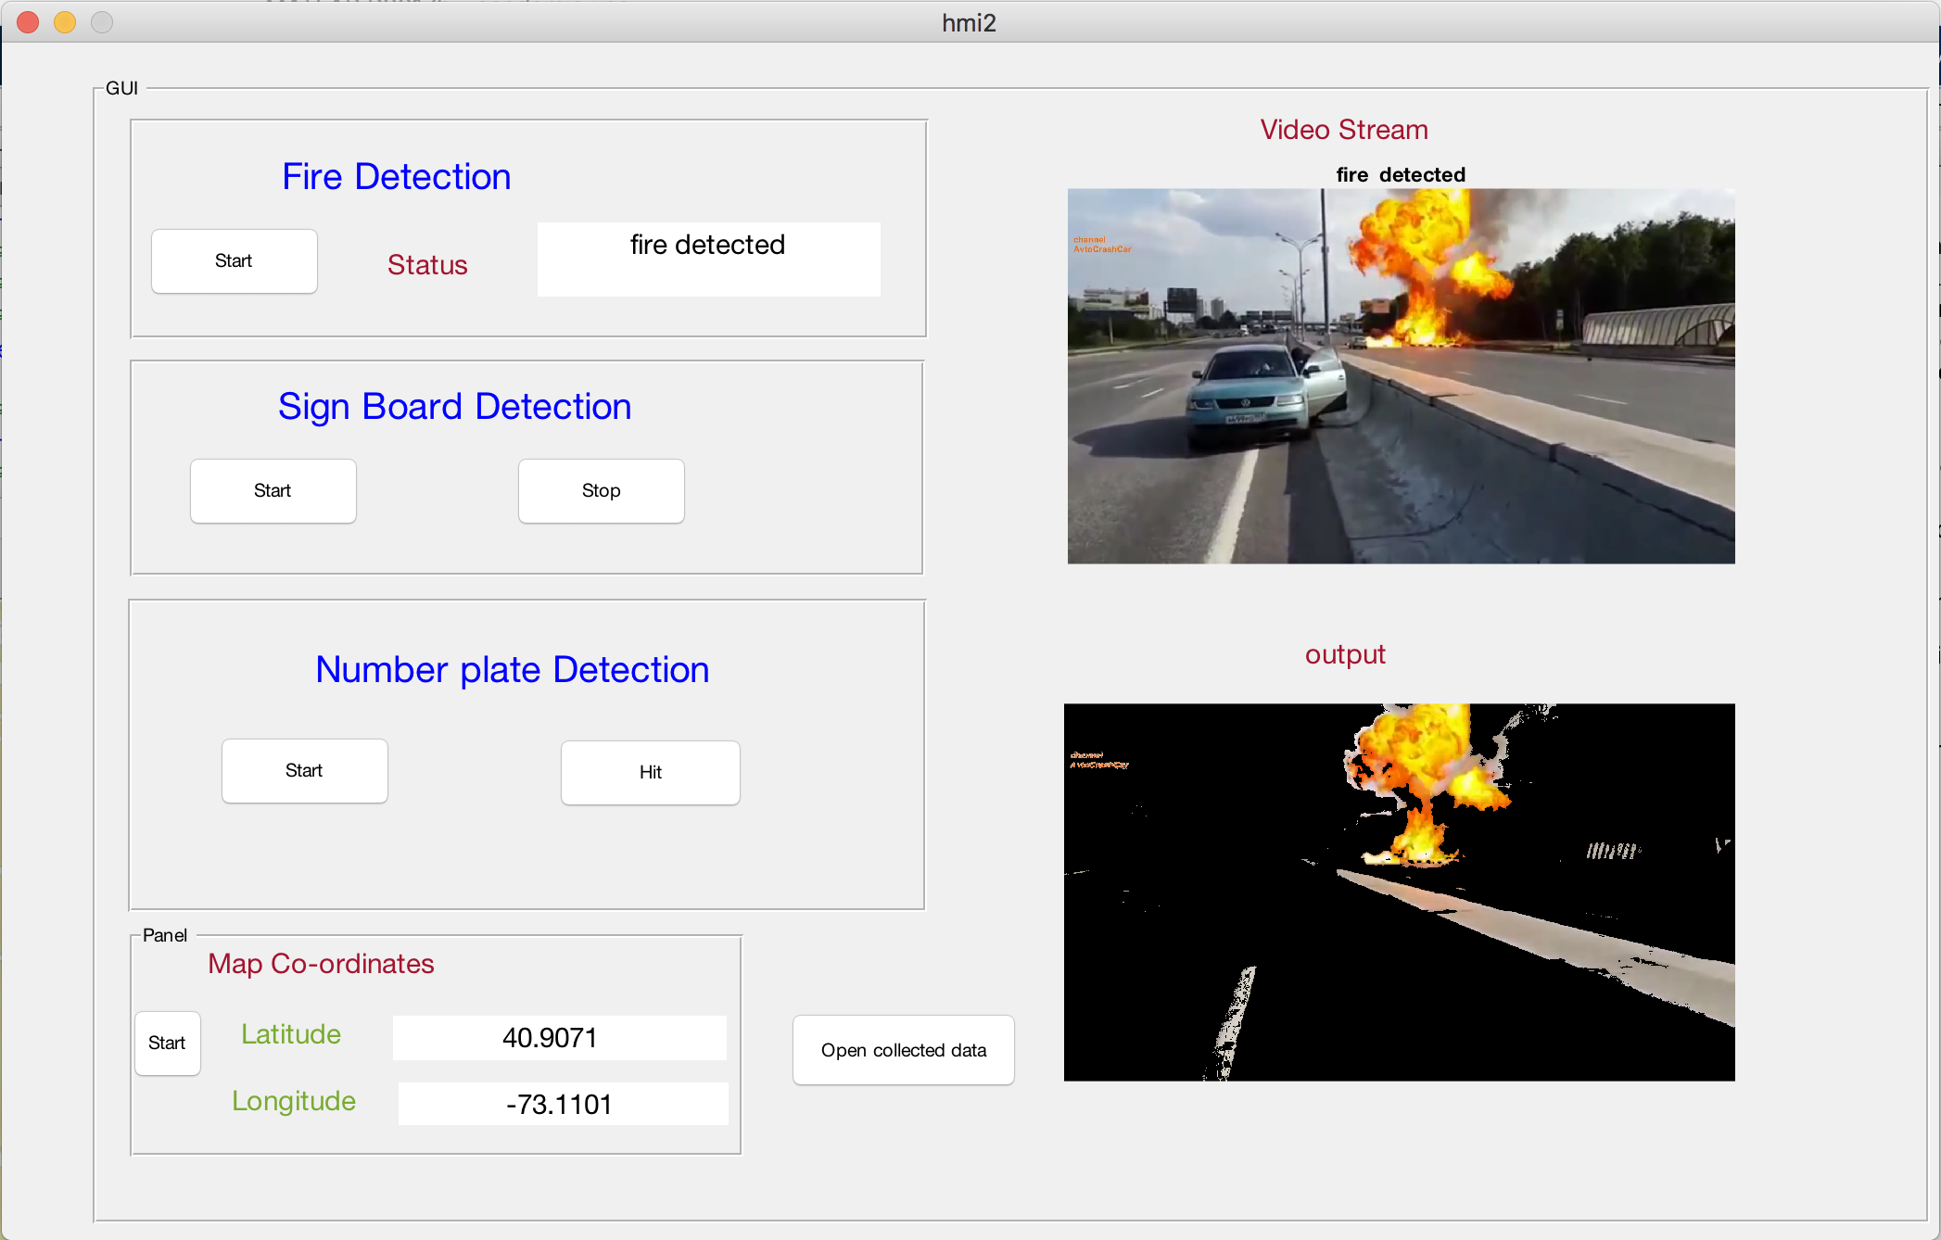
Results : Fire Detection
For fire detection, we made use of an online video.
For displaying the results, we developed a GUI which indicates the entire process of detection and identification. The videos are processed and results containing the information is displayed.
We tested our system by using 10 videos, out of which fire was successfully detected for 9 of them. This gives us an accuracy of 90%. If the model achieves to detect at least 10 pixels of a fire region in a given image, then it is assumed as a correct detection. Whenever fire is detected, our system locates the coordinates and displays it on a map.

Slide 10
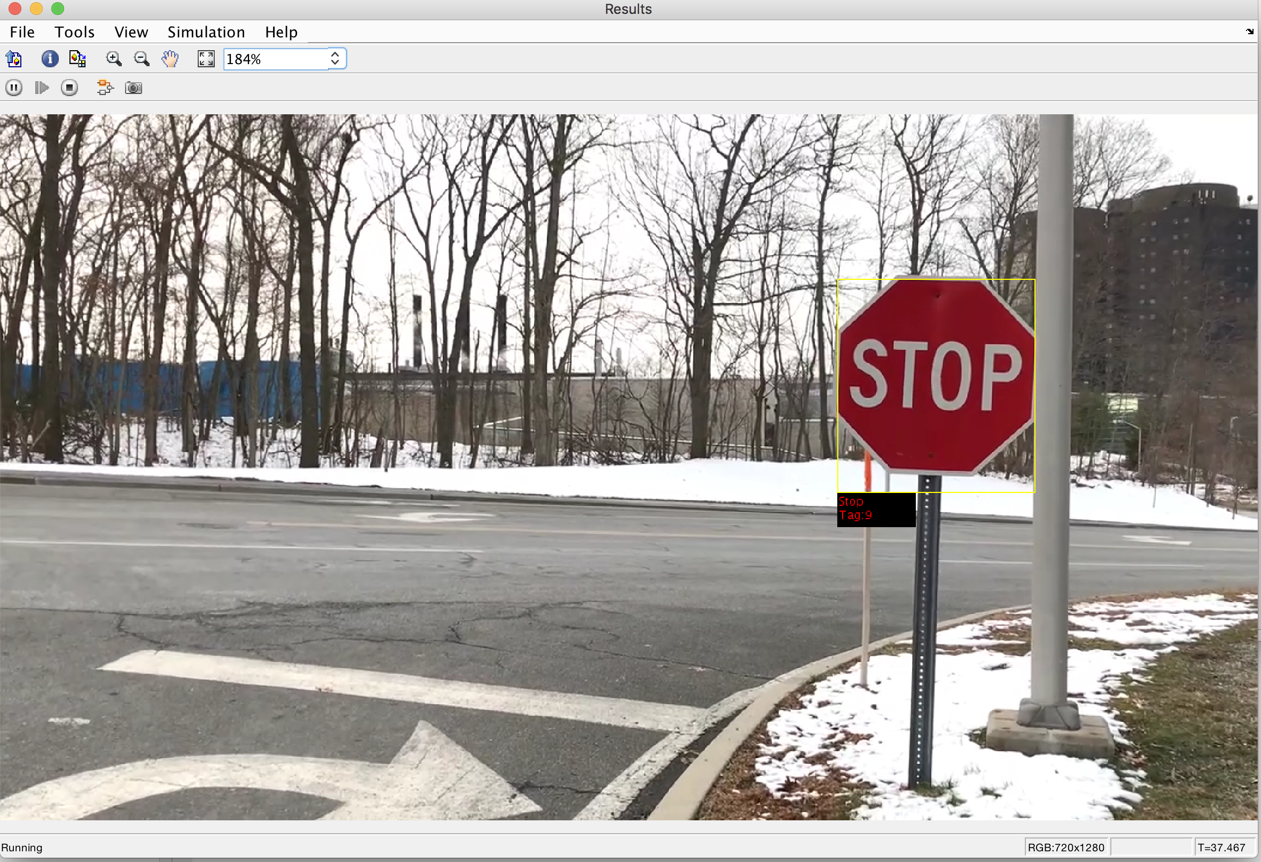
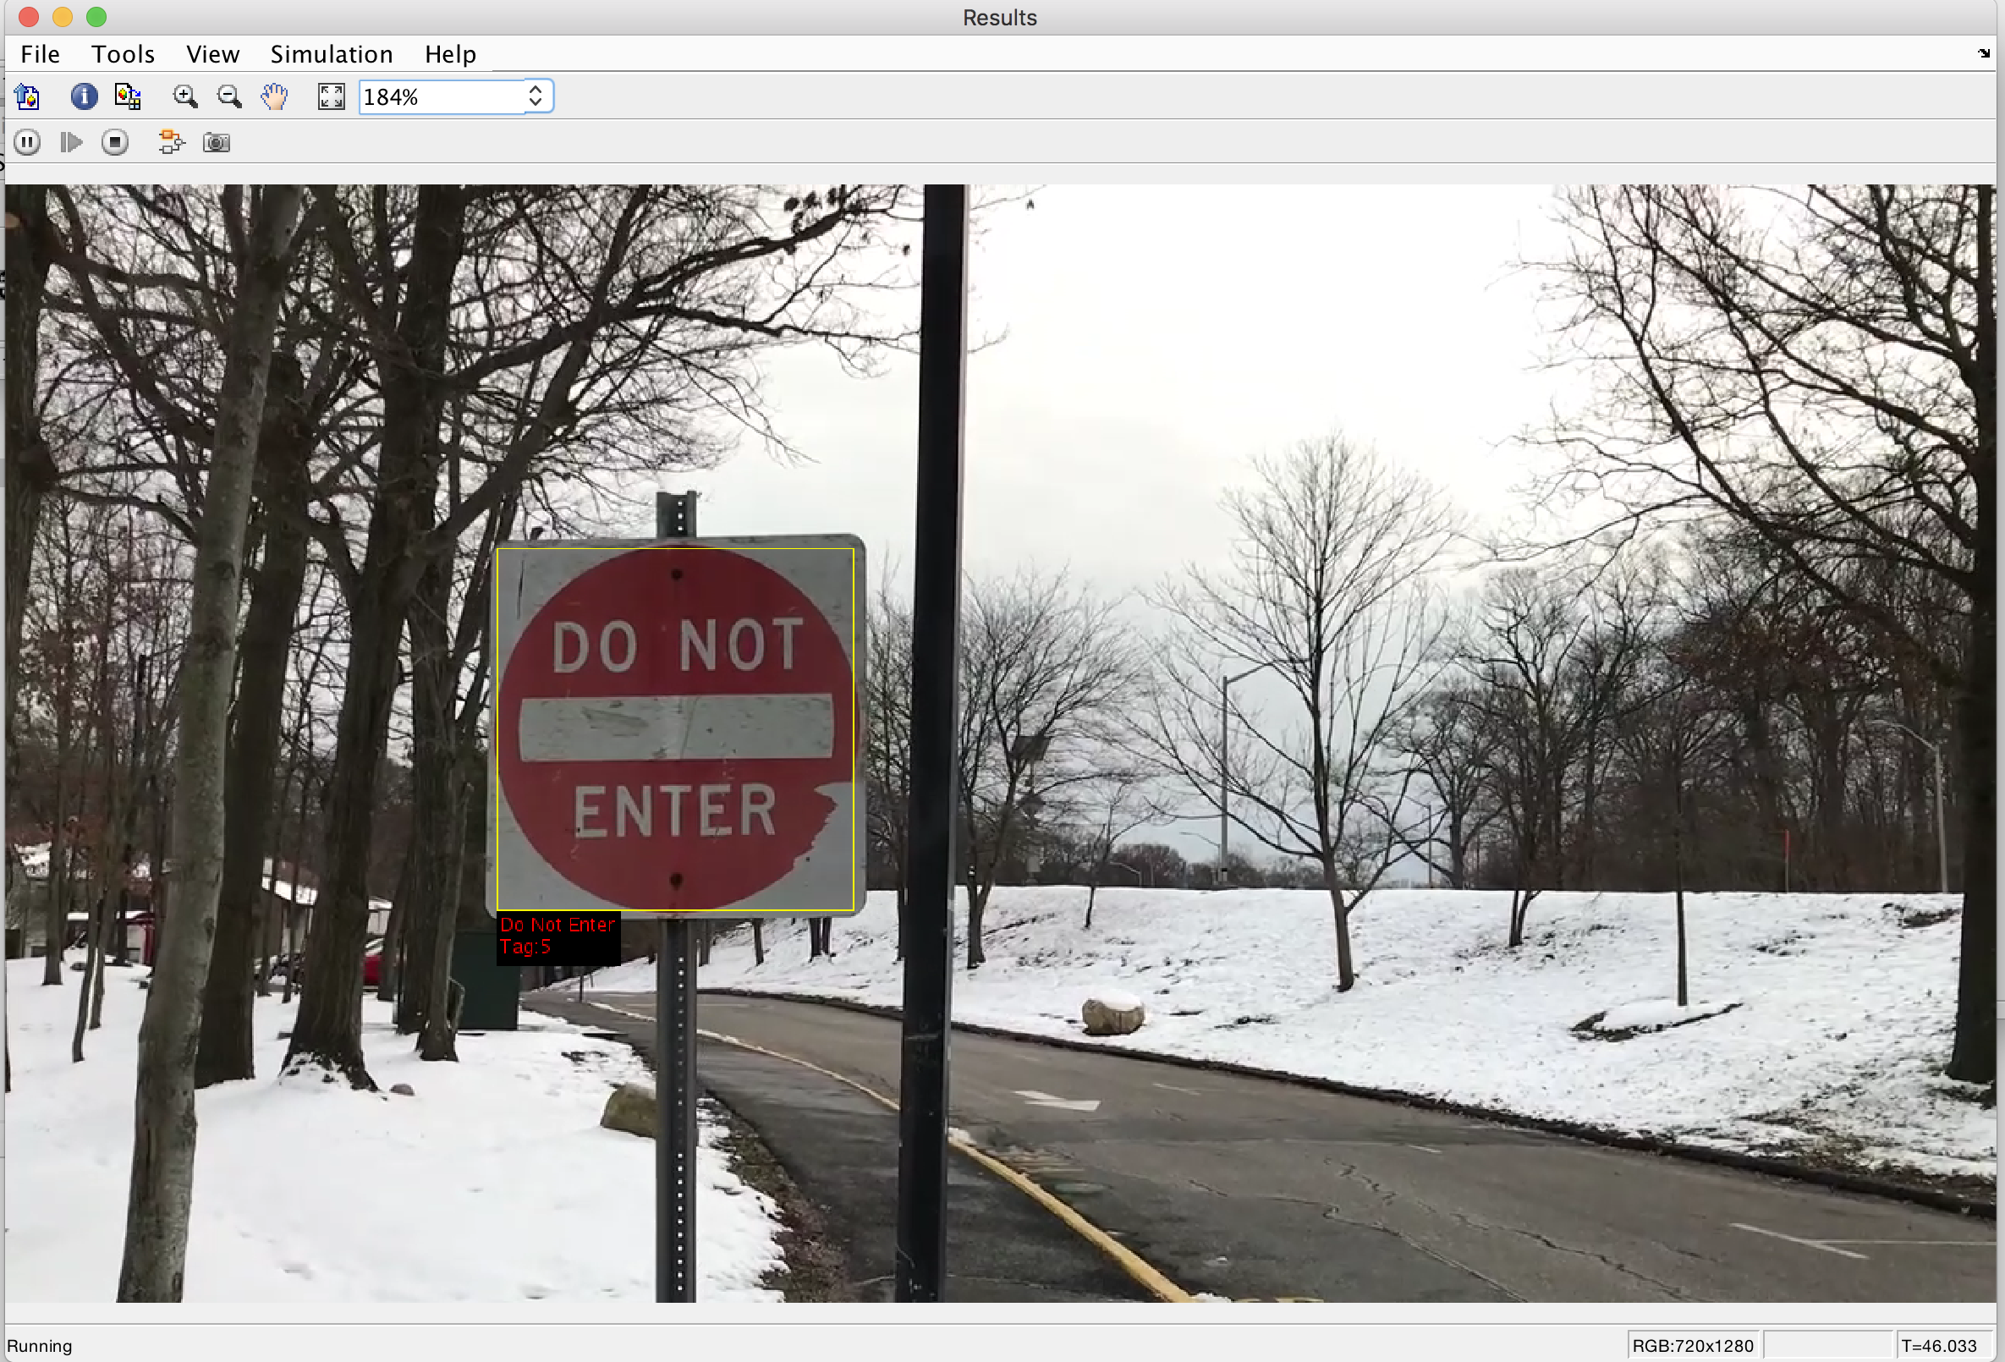
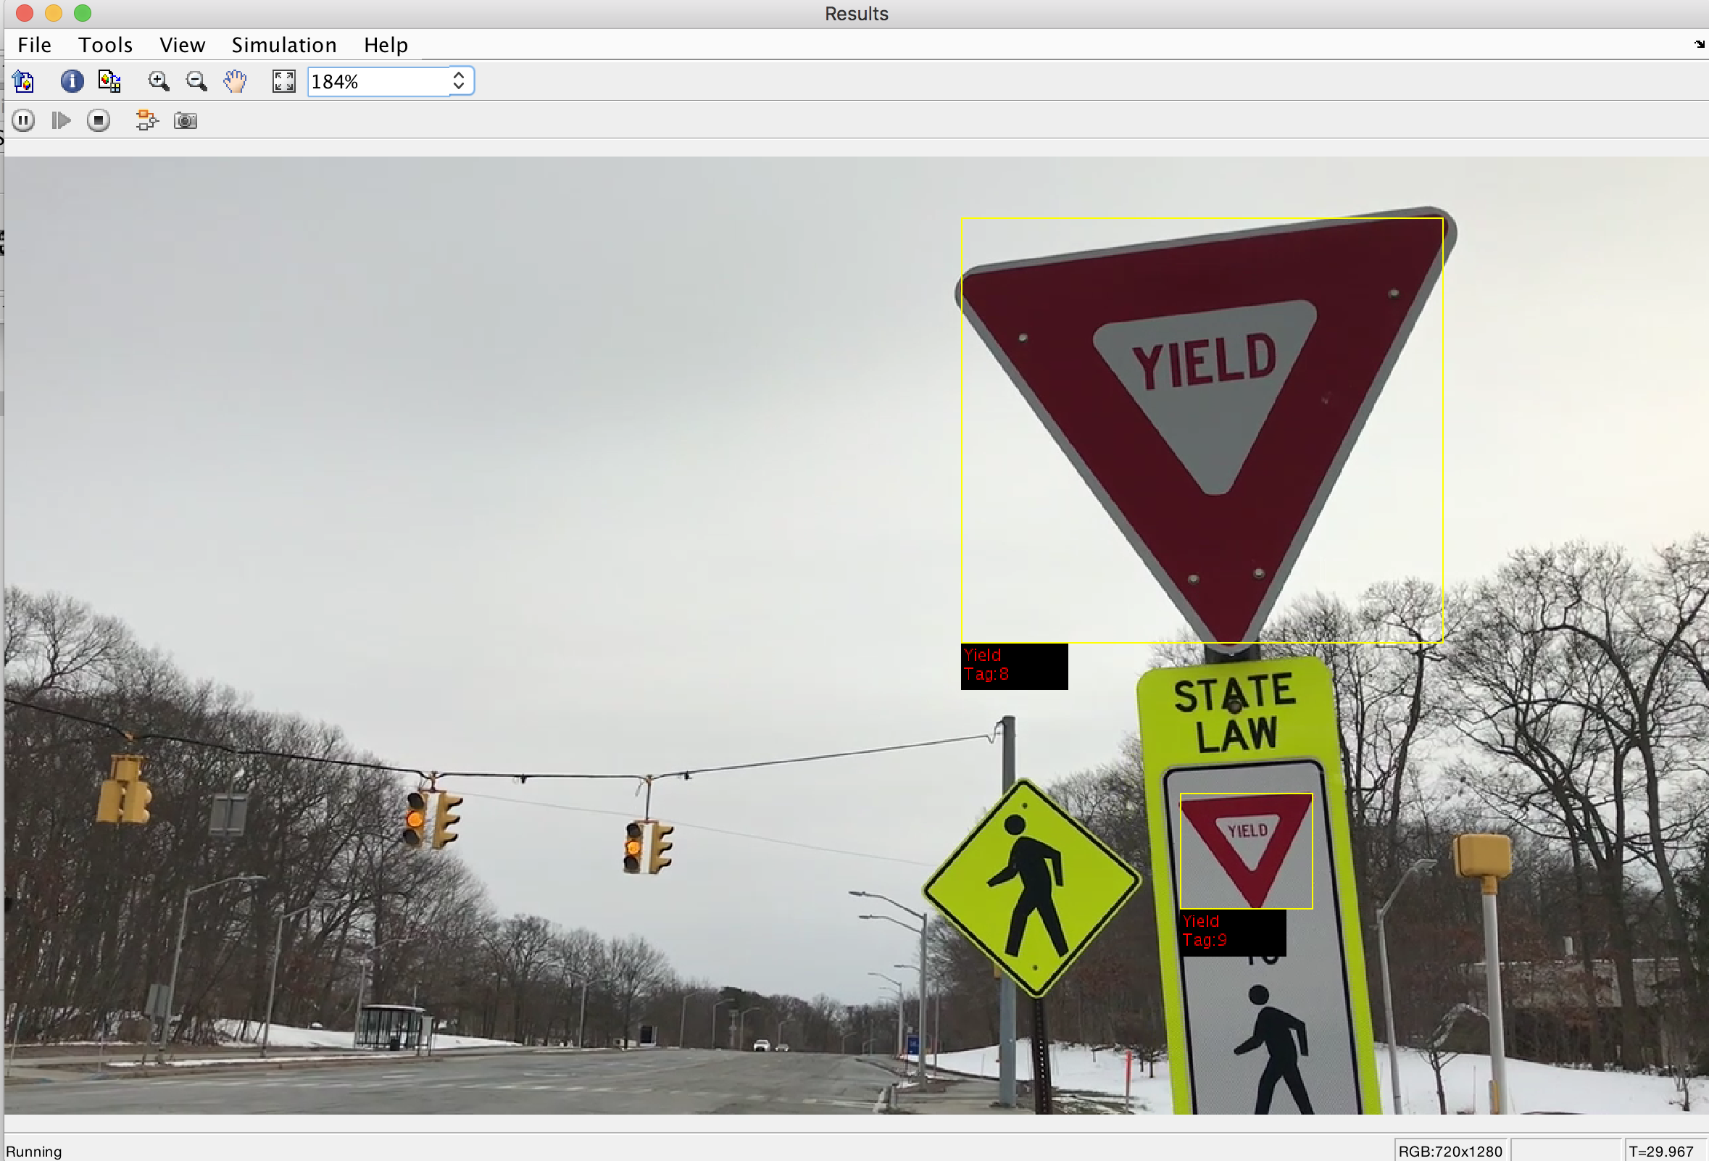
Results: Signboard Detection
We tested our system on 10 videos, out of which sign boards were successfully detected for 9 of them. This gives us an accuracy of 90%. We observed that the detection is inaccurate when video is captured in low light. The system maps the location of these sign boards.

Slide 11
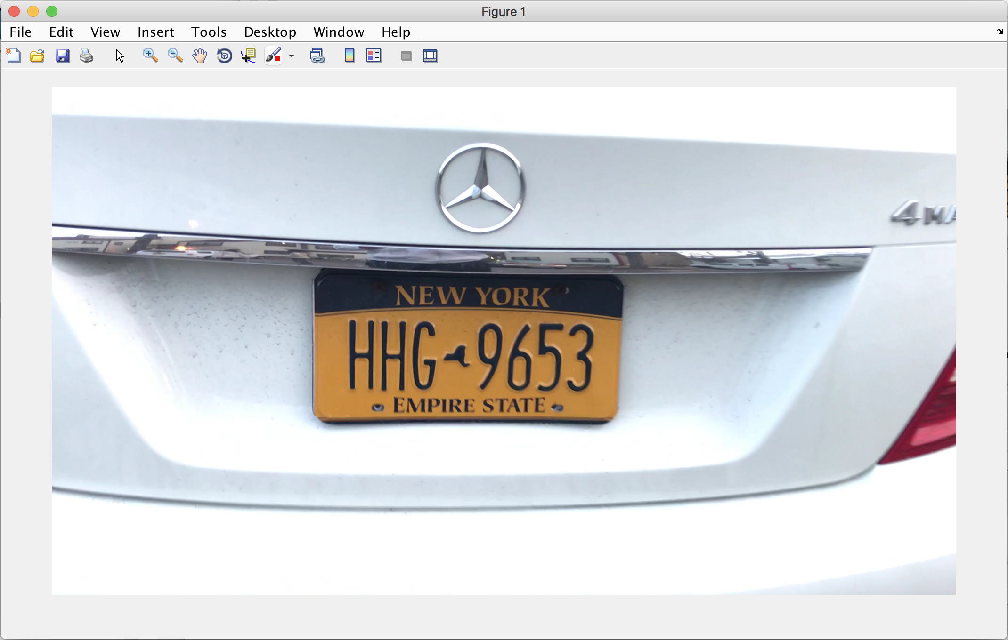
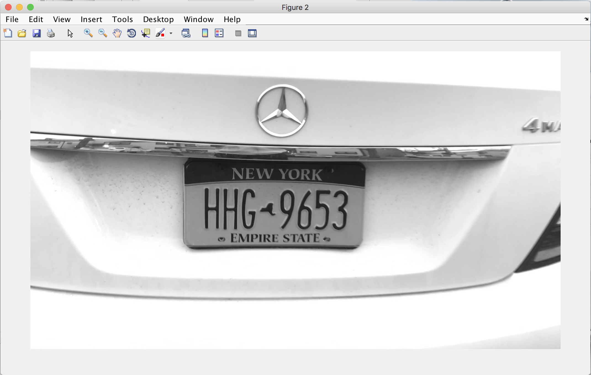
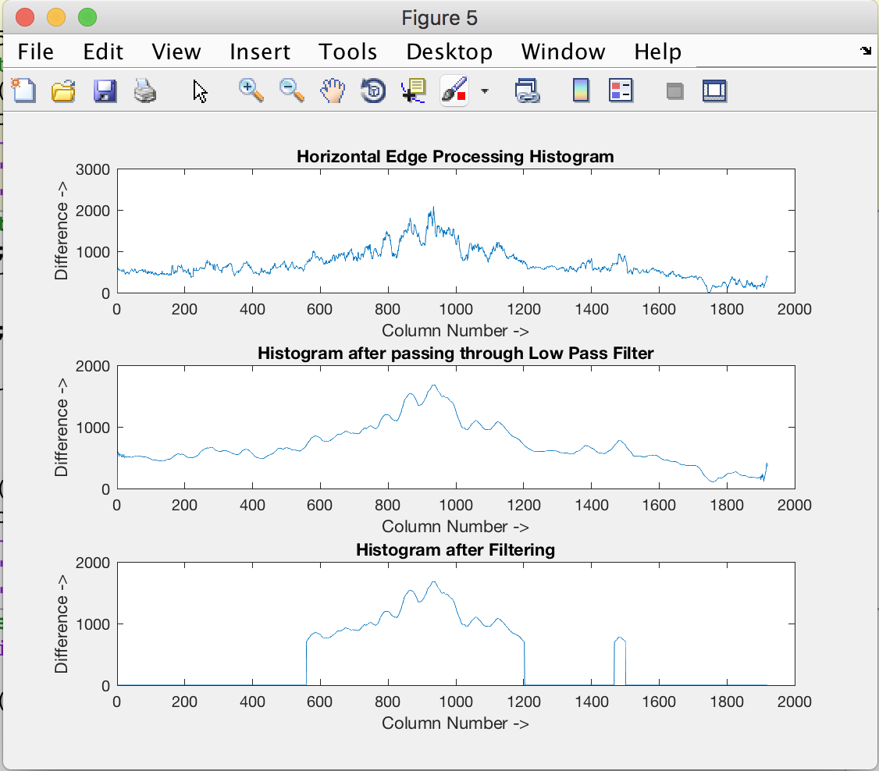
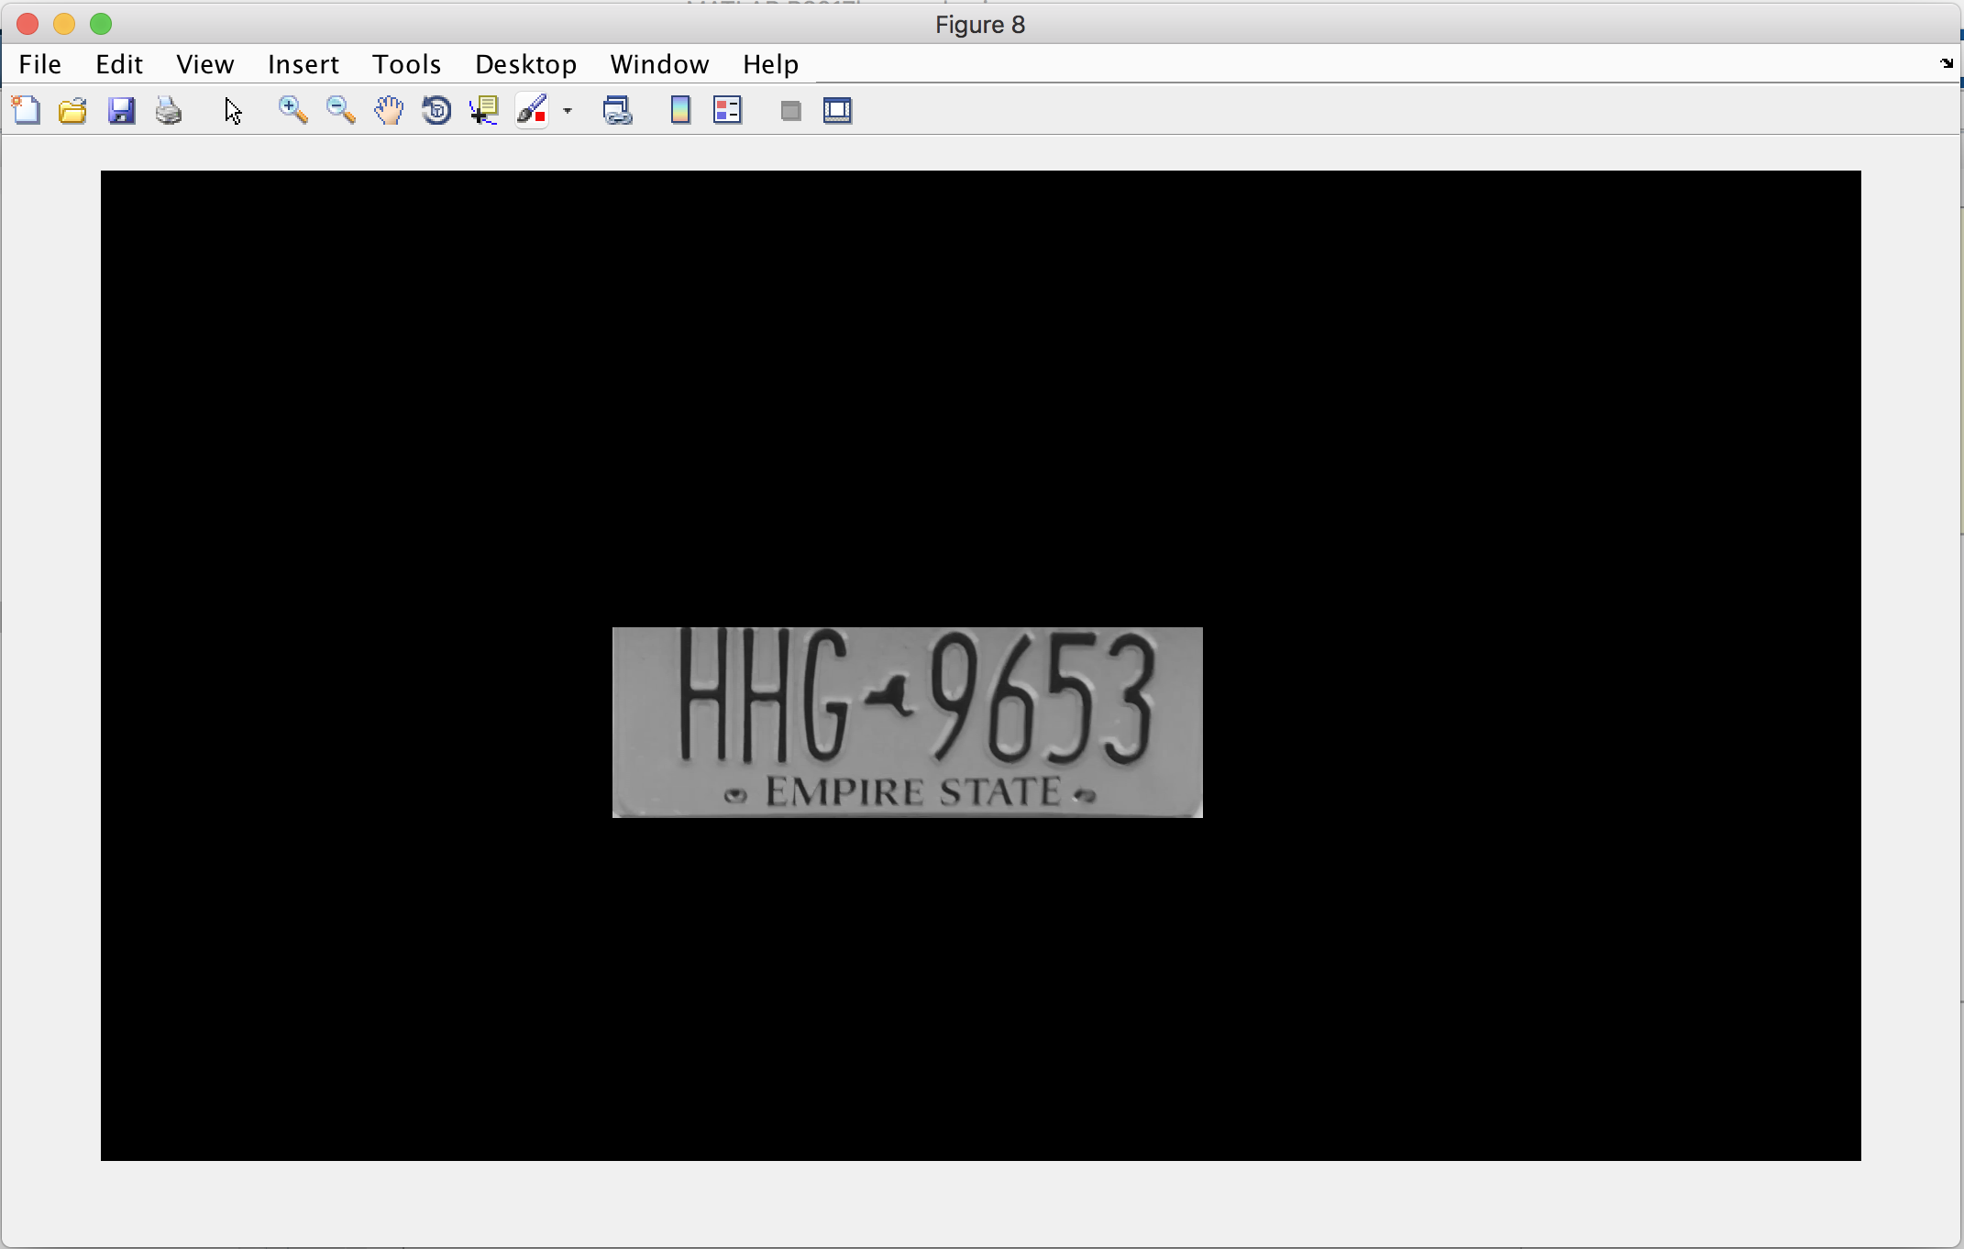
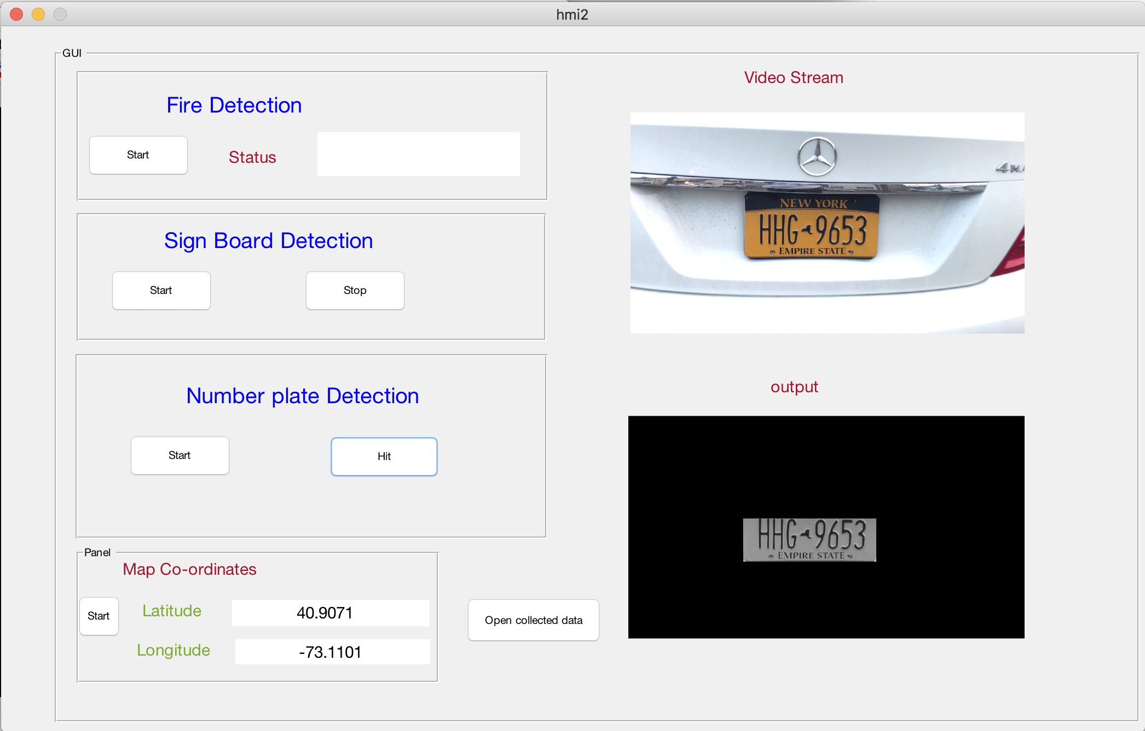
Results: Number plate detection
We tested our system on 10 videos, the system could read number plates for 8 of them, giving us an accuracy of 80%. We observed that the detection is inaccurate when video is captured in low light. The system maps the location of the particular vehicle.

Slide 12
Future work and Conclusion
This project incorporates the various navigation situations into an alerting system designed and implemented on MATLAB. It alerts drivers about hazard signs, hit-and-run accident situations and roadblocks due to natural disasters and ongoing construction.
The full potential of this work will be realized if the coordinates of the hazardous zone can be communicated to other vehicles on the road via Vehicle to vehicle communication and to the collector stations which can upload to cloud database.
From the cloud it can be sent to all collector stations which can communicate this information with all the vehicles which pass by the collector station so that they will be aware of the real time situations on their route. The real time updates can be provided without the need of internet availability.

Slide 13
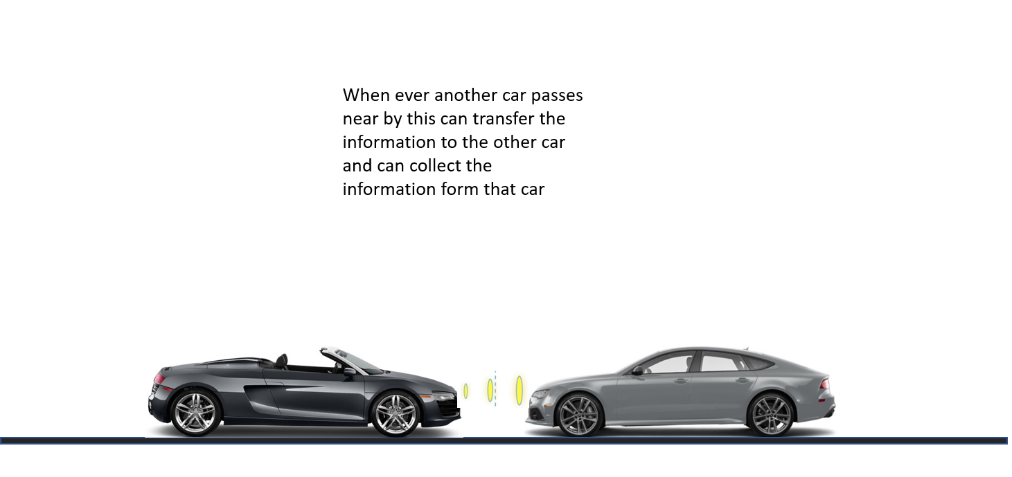
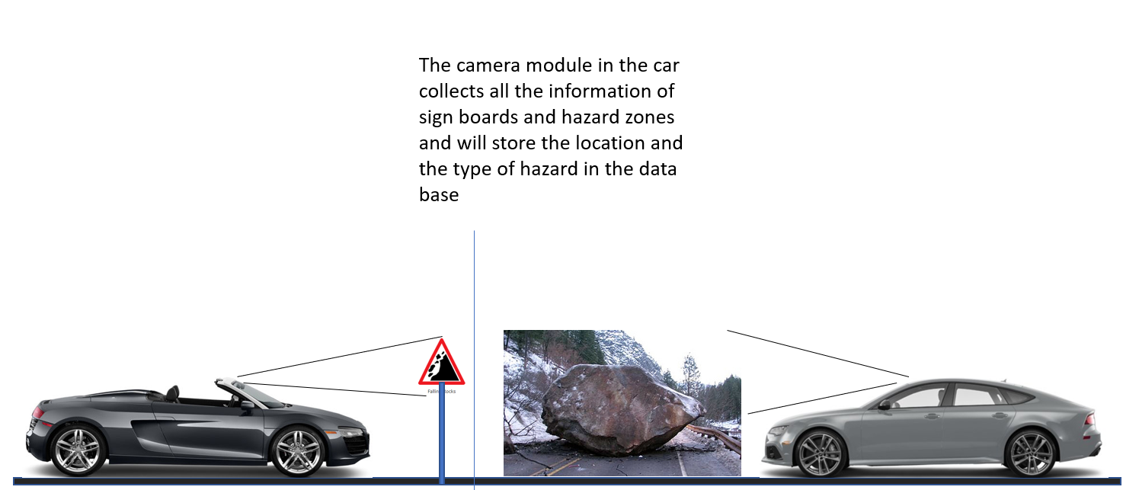
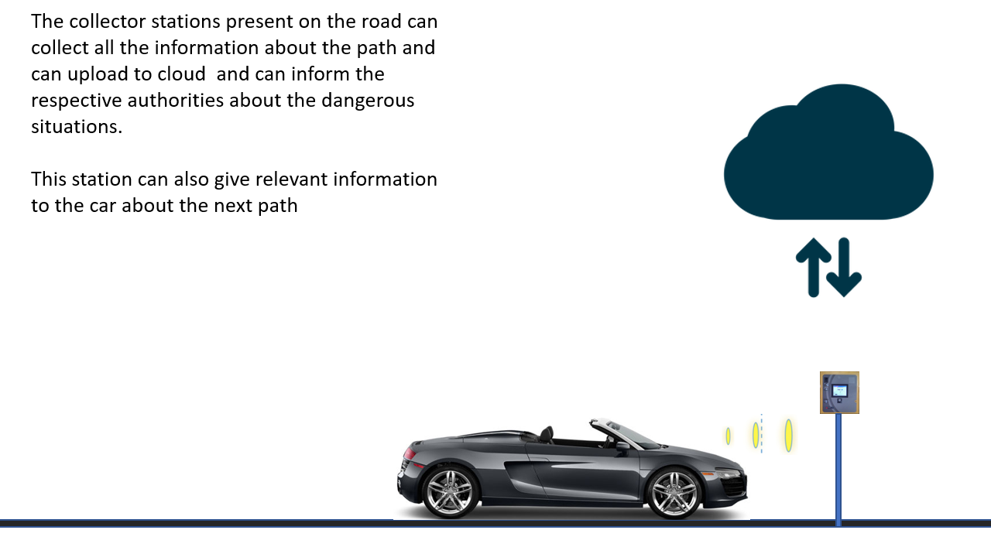
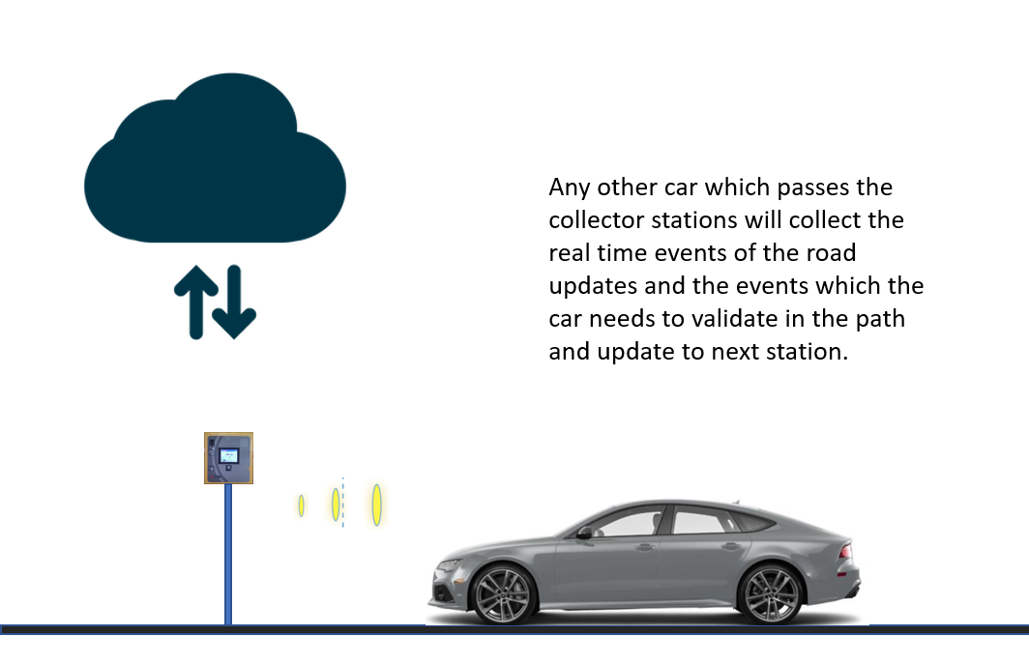

Slide 14
THANK YOU

